Slide 1

Bringing Adult Learning Theories to Life:
Necessities for Accidental Trainers
Lori Ann Roth Ph.D., CPTD, DTM

Slide 2
Who are you and how much do you know?
Get your Cell Phone and
type this in your browser…
Kahoot.it

Slide 3

Challenges for you!
Solve the scenarios in the handout.
What would you do?
Why did you do that?
Is there an adult method or learning theory about this topic?
Notes:
Solve these scenarios
Get into groups – discuss the case study and solve the scenarios
Put the scenarios in the handout
Why did you decide to do this – Handout?

Slide 4

The Tiny Room Challenge
Theory
Notes:
Self-Actualization Theory: Abraham Maslow - Learning is motivated by the hierarchy of needs.
Self-Directed Learning (Malcolm Knowles)
Why It’s Important: Adults often prefer to take control of their learning. Understanding Self-Directed Learning helps trainers support learners in setting their own goals, identifying resources, and evaluating their progress, fostering a sense of autonomy and empowerment.

Slide 5

Restless Students Challenge
Theory
Notes:
Answer – Take a break Allow time for practice and breaks. You could use microlearning to teach your subject in 10 minutes bites, take a break, and continue at another time. Many people like videos or other visual aids for smaller “lessons”.
Answer – Do they want to be there? Andragogy by Malcolm Knowles: This theory contrasts with pedagogy, which is the study of how children learn. Andragogy emphasizes that adults are self-directed learners who bring a wealth of experience to the classroom. They are intrinsically motivated to learn things that are relevant to their work and lives. Trainers who understand andragogy will create training programs that are interactive, problem-centered, and allow for learner autonomy.
Knowles' principles from the 1980s remain core to adult learning, but their application has evolved.
Focus: Adult learners are self-directed, experience-based, and problem-centered.
Gamification in Learning
Why It’s Important: Gamification uses game design elements in non-game contexts to engage learners and motivate them. Trainers can incorporate gamification to make learning experiences more interactive and enjoyable, which can enhance motivation and retention.
Cognitive Load Theory (John Sweller)
Why It’s Important: This theory focuses on the limitations of working memory and the importance of designing instruction that reduces unnecessary cognitive load. Trainers can apply this by organizing content in a way that is easily digestible, using techniques like chunking information, and avoiding information overload.

Slide 6

Interview Skills Challenge
Theory
Notes:
Answer –Lack of Practical Application: The training focused heavily on theoretical knowledge without sufficient opportunities for practical application.
Ignoring Learning Styles: Sandy’s approach did not cater to diverse learning styles, leading to frustration among some interns.
Social Cognitive Theory: Albert Bandura - Learning through observation, imitation, and modeling.
Constructivism: Jean Piaget - Learners actively construct knowledge through experiences.
Social Learning Theory (Continued Influence)
Bandura's theory, although older, continues to shape learning approaches.
Focus: Learning through observation and imitation of others.
Relevance: Important for understanding how adults learn in social and organizational contexts.
Self-Efficacy Theory (Albert Bandura)
Why It’s Important: This theory emphasizes the importance of a learner's belief in their ability to succeed. Trainers can enhance self-efficacy by providing clear goals, constructive feedback, and opportunities for mastery, which can significantly impact learners' motivation and performance.

Slide 7

Motivation Challenge
Theory
Notes:
Answer – Use a Learner-centered approach Focusing on the individual needs and preferences of learners.
“Adults vote with their feet”
Self-directed learning by Sharon Merriam and Phyllis King: This theory builds on andragogy by acknowledging that adults take ownership of their learning. They set goals, identify learning needs, and choose learning methods. Trainers who understand self-directed learning will create flexible learning environments that cater to different learning styles and allow learners to take charge of their learning journey.
Problem-Based Learning (PBL)
Why It’s Important: PBL involves learners working on real-world problems without predefined solutions, encouraging critical thinking, problem-solving, and self-directed learning. Trainers can use PBL to make learning more relevant and engaging, helping adults apply what they learn in practical settings.
Motivational Theory (John Keller’s ARCS Model)
Why It’s Important: Motivation is a key factor in adult learning. Keller’s ARCS Model (Attention, Relevance, Confidence, Satisfaction) provides a practical framework for designing learning experiences that capture and maintain learners' motivation. Understanding what drives adult learners can help trainers keep them engaged and committed to the learning process.
Transformative Learning (Jack Mezirow)
Why It’s Important: Transformative Learning emphasizes critical reflection and the transformation of perspectives, which is crucial for adult learners seeking to make meaningful changes in their personal or professional lives. This theory encourages trainers to create opportunities for reflection and discussion that can lead to deep, lasting learning.

Slide 8

The Games Challenge
Theory
Notes:
Constructivism (Jean Piaget, Lev Vygotsky)
Why It’s Important: Constructivism posits that learners construct their own understanding based on their experiences and reflections. Trainers can use this theory to design learning environments that encourage exploration, problem-solving, and discovery, allowing learners to build knowledge in meaningful ways.
Experiential Learning (David Kolb)
Why It’s Important: This theory highlights the significance of learning through experience, which is especially relevant for adults who bring a wealth of personal and professional experiences to the learning environment. The Experiential Learning Cycle (Concrete Experience, Reflective Observation, Abstract Conceptualization, Active Experimentation) provides a framework for designing effective learning activities.
Andragogy (Malcolm Knowles)
Why It’s Important: This theory specifically addresses adult learners, emphasizing principles such as self-direction, the importance of experience, readiness to learn, and problem-solving. It helps trainers tailor their approach to meet the needs of adult learners.
Add something about process and steps – mastery. Who does the master instructional method?

Slide 9
Maslow’s hierarchy of needs
Piaget Constructivism
Gamification in Learning
Knowles Andragogy & Self-Directed Learning
Kolb Experiential Learning
Mezirow’s Transformative Learning
Sweller’s Cognitive Load Theory
Gagne’s
Nine
Events
Of
Instruction
Bandura – Social Cognitive & Self-Efficacy
Problem-Based Learning (PBL)
Keller’s ARCS Model- Motivational Theory
Regan’s Action Learning

Slide 10
Action Plan – What did I learn?
“People don't care how much you know until they know how much you care”
― Theodore Roosevelt
Notes:
Understanding these theories will equip new trainers with the knowledge and skills to create effective training programs for adults. In addition to the above, there are other theories that address adult motivation, learning styles, and the importance of the social context for learning. Trainers who continue to learn about adult learning will find themselves better prepared to meet the needs of their diverse learners.
. Also, there will be an action plan for each person to note how they can use this information to help people on the job learn best.

Slide 11

What was your best take away?
Notes:
1. Speed Sharing and Stacking:
This is a quick and energetic activity that gets everyone talking.
Materials: Sticky notes and markers (enough for each participant)
Instructions:
Pose a question related to the training content. It could be something like "What's your best tip for overcoming X challenge?" or "How can we best implement this new strategy?"
Give participants 2-3 minutes to write their ideas on sticky notes.
Once the time is up, instruct everyone to find a partner (or small group of 3-4).
Each person shares their idea with the group, then sticks their note on a central board or wall.
Partners then take turns reading the notes on the board and "stacking" similar ideas together. If there are duplicates, they can be combined onto one note.
After stacking, open the floor for a quick discussion about the most popular or interesting ideas.
Finally, they will share their ideas & play a game - "What is my best idea?" at the end as a review.

Slide 12

Your feedback helps ATD continue to provide top-notch educational programs that help you stay on top of a changing profession.
The evaluation form for this session is available via QR code and at the following link: https://core4.td.org/.
FEEDBACK COUNTS

Slide 13
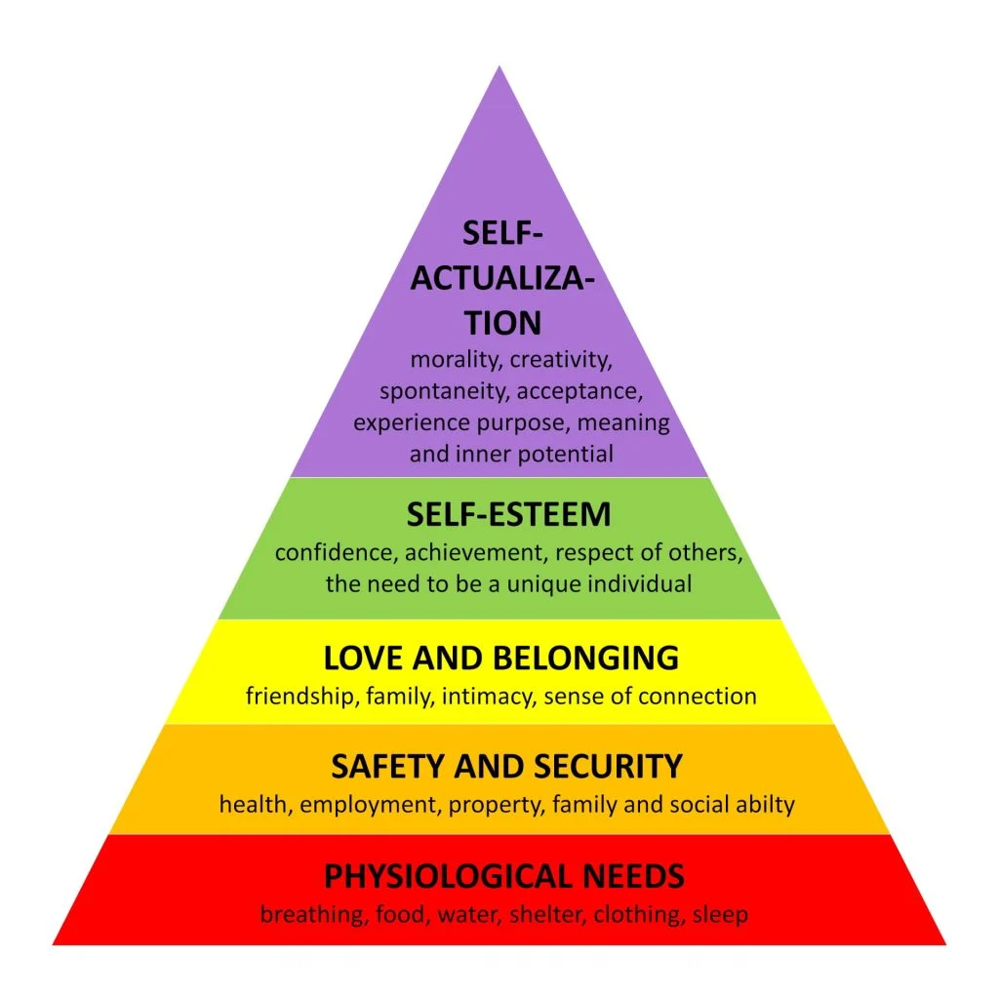
Maslow’s hierarchy of Needs
Return
Notes:
https://www.simplypsychology.org/maslow.html
Maslow's hierarchy helps educators understand learners' basic needs, which must be met before focusing on learning. By addressing these needs, educators create supportive learning environments and motivate adults to reach their full potential. This framework guides educators in tailoring instruction to individual learners and overcoming potential learning barriers.

Slide 14
Malcolm Knowles Andragogy & Self-Directed Learning
Learners set their own goals
Identify resources
Evaluate their own progress
Autonomy and Empowerment
Self direction
Experience
Readiness to learn
Problem-solving
Andragogy
Return
Notes:
Androgogy
This theory specifically addresses adult learners, emphasizing principles such as self-direction, the importance of experience, readiness to learn, and problem-solving. It helps trainers tailor their approach to meet the needs of adult learners.
Self-Directed Learning (Malcolm Knowles)
Adults often prefer to take control of their learning. Understanding Self-Directed Learning helps trainers support learners in setting their own goals, identifying resources, and evaluating their progress, fostering a sense of autonomy and empowerment.

Slide 15

Gamification in Learning
Gamification
Uses game design elements in non-game contexts
Engages and motivates learners
Enhances retention
Return
Notes:
Gamification uses game design elements in non-game contexts to engage learners and motivate them. Trainers can incorporate gamification to make learning experiences more interactive and enjoyable, which can enhance motivation and retention.
The term gamification was coined in 2003 by Nick Pelling.
Constructivism posits that learners construct their own understanding based on their experiences and reflections. Trainers can use this theory to design learning environments that encourage exploration, problem-solving, and discovery, allowing learners to build knowledge in meaningful ways.

Slide 16

Lev Vygotsky & Jean Piaget Constructivism
Constructivism
Rely on learner’s past experiences
Learners can reflect on experiences
Encourages exploration and problem solving
Learners build knowledge in meaningful ways.
Return
Notes:
Constructivism posits that learners construct their own understanding based on their experiences and reflections. Trainers can use this theory to design learning environments that encourage exploration, problem-solving, and discovery, allowing learners to build knowledge in meaningful ways.

Slide 17

Bandura Social/Cognitive
Learning through
  observation
  Imitation
  Modeling
Social interaction (peer learning)
Use group activities
  Role plays
  Case studies
  Scavenger hunts
Mentoring
  Interact with experienced mentor
Return
Notes:
This theory emphasizes learning through observation, imitation, and modeling, underscoring the importance of social interactions in the learning process. Trainers can leverage this by incorporating group activities, peer learning, and mentoring opportunities into their programs.

Slide 18
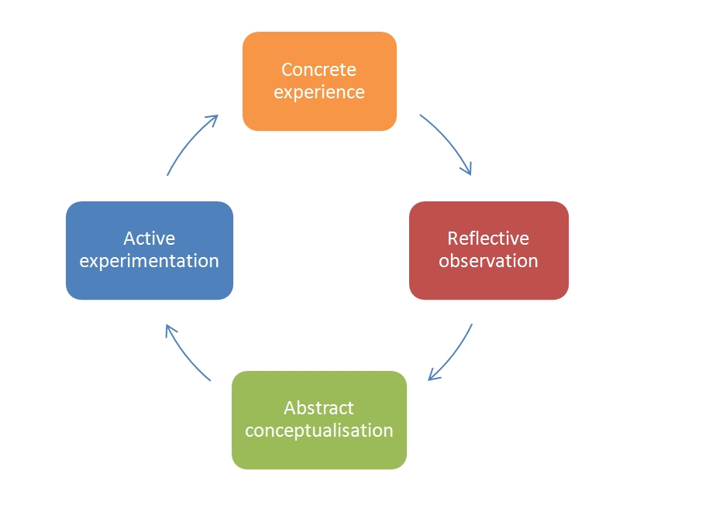
Kolb’s Experiential Learning
Adults bring personal and professional experiences to their learning.
Return
Notes:
This theory highlights the significance of learning through experience, which is especially relevant for adults who bring a wealth of personal and professional experiences to the learning environment. The Experiential Learning Cycle (Concrete Experience, Reflective Observation, Abstract Conceptualization, Active Experimentation) provides a framework for designing effective learning activities.

Slide 19
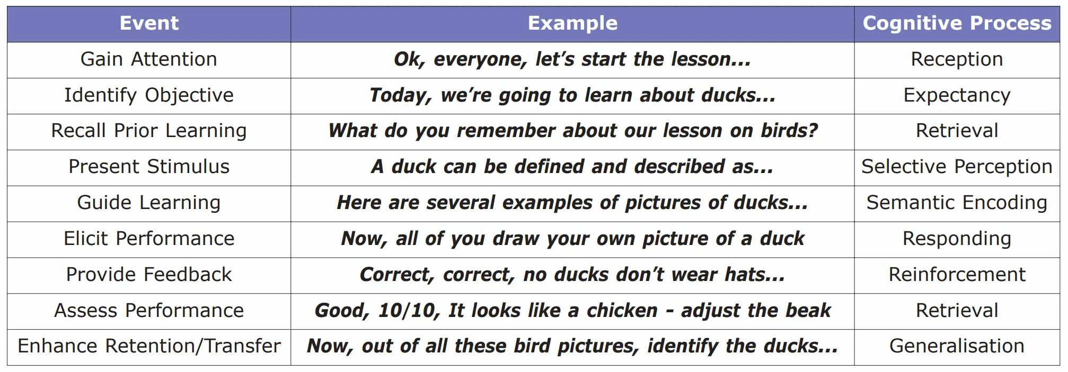
Robert Gagné’s 9 Events of Instruction
Return
Notes:
https://www.simplypsychology.org/conditions-of-learning-gagne.html
Gagne’s theory of instructional learning offers a more rounded theory of learning and instruction than other cognitive psychologists; and one which offers far more directive advice on how the instructors should manage individual lessons. These conditions outline a sequence of events that enhance the learning process and promote effective instruction. The nine events provide a framework for designing and delivering instruction in a structured and systematic manner.

Slide 20
Sweller’s Cognitive Load Theory
Focuses on the limitations of working memory
Organize content in smaller pieces
Chunking
Microlearning
Use visuals
Multi-media learning
Minimize distractions
Build Schemas and connect new information to existing knowledge.
Return
Notes:
This theory focuses on the limitations of working memory and the importance of designing instruction that reduces unnecessary cognitive load. Trainers can apply this by organizing content in a way that is easily digestible, using techniques like chunking information, and avoiding information overload.
Key Components of Cognitive Load Theory
Working Memory Limitations: Human working memory can only process a limited amount of information at a time. Overloading it hinders learning.
Cognitive Load Types:
Intrinsic Cognitive Load: Inevitable cognitive effort required to process new information.
Extraneous Cognitive Load: Mental effort wasted on irrelevant information or presentation formats.
Germane Cognitive Load: Mental effort used to build schemas and connect new information to existing knowledge.
Schema Acquisition: Learning involves building mental models or schemas. Effective instruction facilitates schema development.

Slide 21

Jack Mezirow’s Transformative Learning
Make meaningful changes in personal and professional lives through…
Critical reflection
Different perspectives
Important discussions
Journaling
Debates
Mentoring
Create opportunities that can lead to deep, lasting learning.
Return
Notes:
Transformative Learning emphasizes critical reflection and the transformation of perspectives, which is crucial for adult learners seeking to make meaningful changes in their personal or professional lives. This theory encourages trainers to create opportunities for reflection and discussion that can lead to deep, lasting learning.

Slide 22
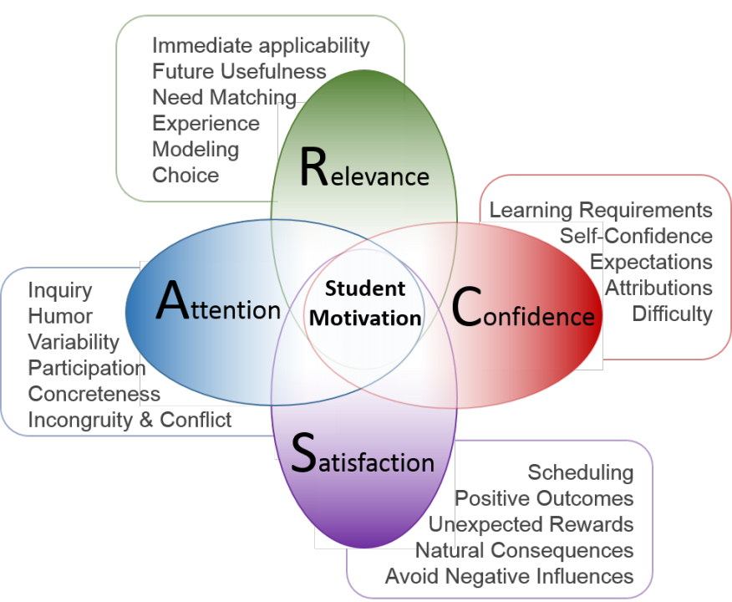
John Kellers ARCS Model- Motivational Theory
Understanding what drives your learners
Return
Google Images
Notes:
Motivation is a key factor in adult learning. Keller’s ARCS Model (Attention, Relevance, Confidence, Satisfaction) provides a practical framework for designing learning experiences that capture and maintain learners' motivation. Understanding what drives adult learners can help trainers keep them engaged and committed to the learning process.

Slide 23
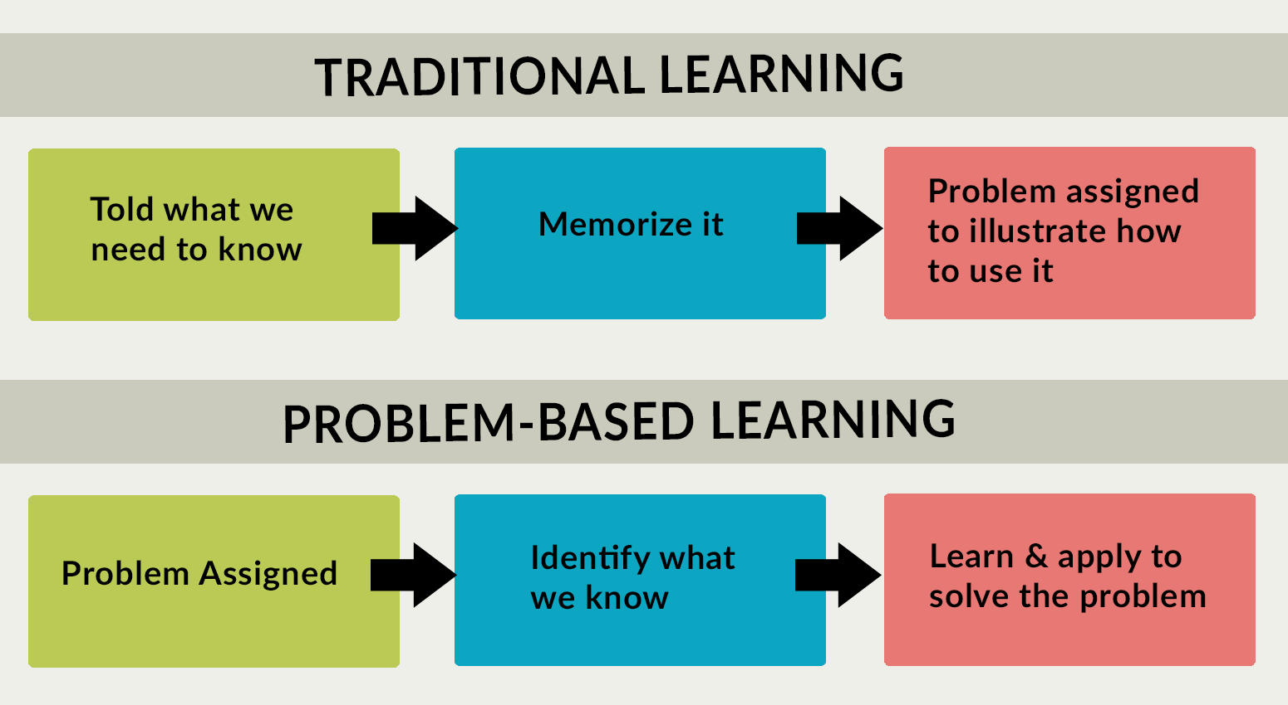
Problem-Based Learning
Real-world problems without predefined solutions
encouraging:
critical thinking
problem-solving
self-directed
learning
Return
Emory.edu/
Notes:
PBL involves learners working on real-world problems without predefined solutions, encouraging critical thinking, problem-solving, and self-directed learning. Trainers can use PBL to make learning more relevant and engaging, helping adults apply what they learn in practical settings.
Problem-based learning (PBL) is a student-centered approach in which students learn about a subject by working in groups to solve an open-ended problem. This problem is what drives the motivation and the learning.
Graphic from: https://sph.emory.edu/rollins-tlc/course-design/problem-based-learning/index.html

Slide 24
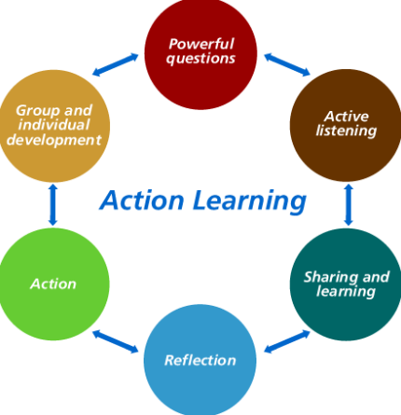
Rev Regan’s Action Learning
Apply learning directly to their work
while receiving support from peers and mentors
Return
Notes:
Action Learning focuses on solving real-world problems through a cycle of action and reflection. It’s particularly effective for adult learners in professional settings, as it allows them to apply learning directly to their work while receiving support from peers and mentors.
Action learning (AL) is a problem-solving strategy and experiential learning approach where the collective wisdom of the group is utilised. In action learning a small group of people are presented with real problems that they take action on and then learn from the process and the results. People learn by doing and then reflect on what’s been learned to inform future actions.

